Slide 1
OBI Workshop Vancouver 2009:
Use case:
Immune Epitope Database
Bjoern Peters
02/02/09

Slide 2
Overview
Introduction
Epitopes and the Immune Epitope Database (IEDB)
Goals of using OBI for the IEDB
Implementation

Slide 3
CD8⁺ T cell epitopes in viral infection
Mouse
Virus
MHC-I
APC

Slide 4
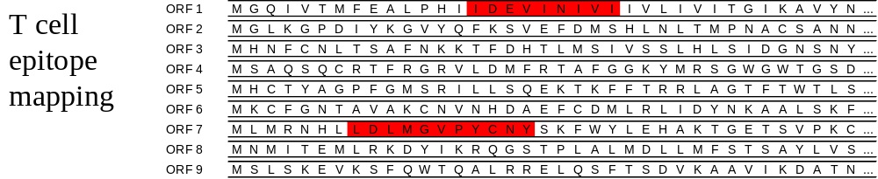
CD8⁺ T cell epitopes in viral infection
Mouse
T
Proliferation
T
Cytokine Release
T
Virus
TCR
CD8
MHC-I
Cytotoxicity
APC

Slide 5
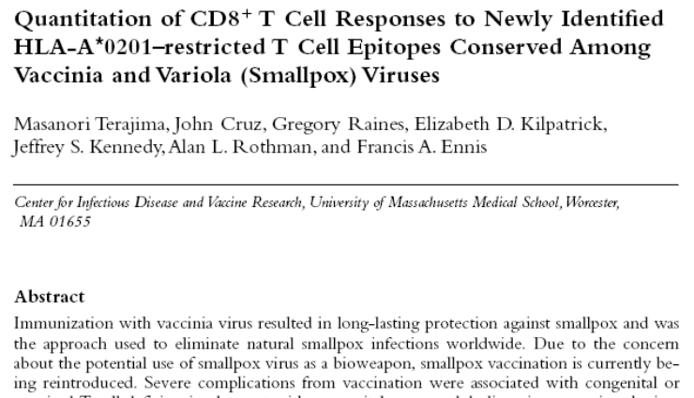

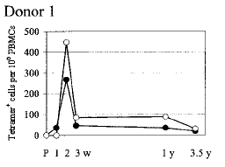
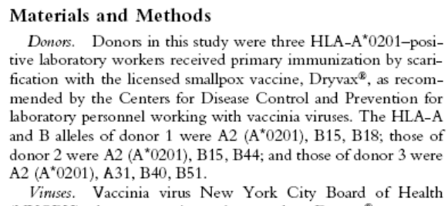
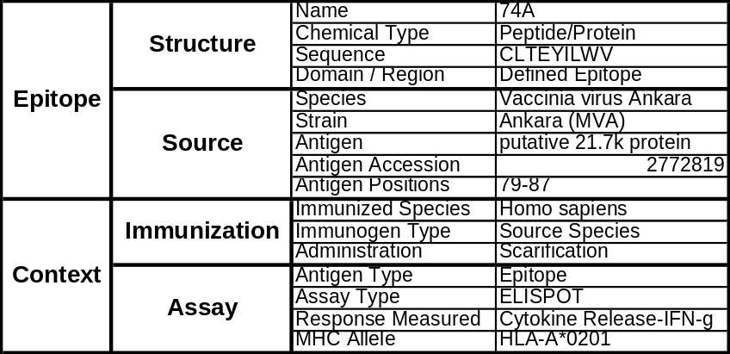
The Immune Epitope Database (IEDB)
Goal: To catalog, organize and make accessible immune epitope information
Epitope discovery
contract submission
Literature curation
IEDB
www.immuneepitope.org

Slide 6
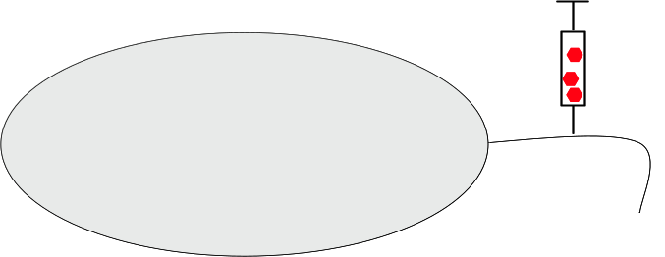
Design of the IEDB:
Epitope defining experiments have shared components
T
T
B
APC
APC
MHC Binding
MHC Ligand Elution
T Cell Response
B Cell Response

Slide 7
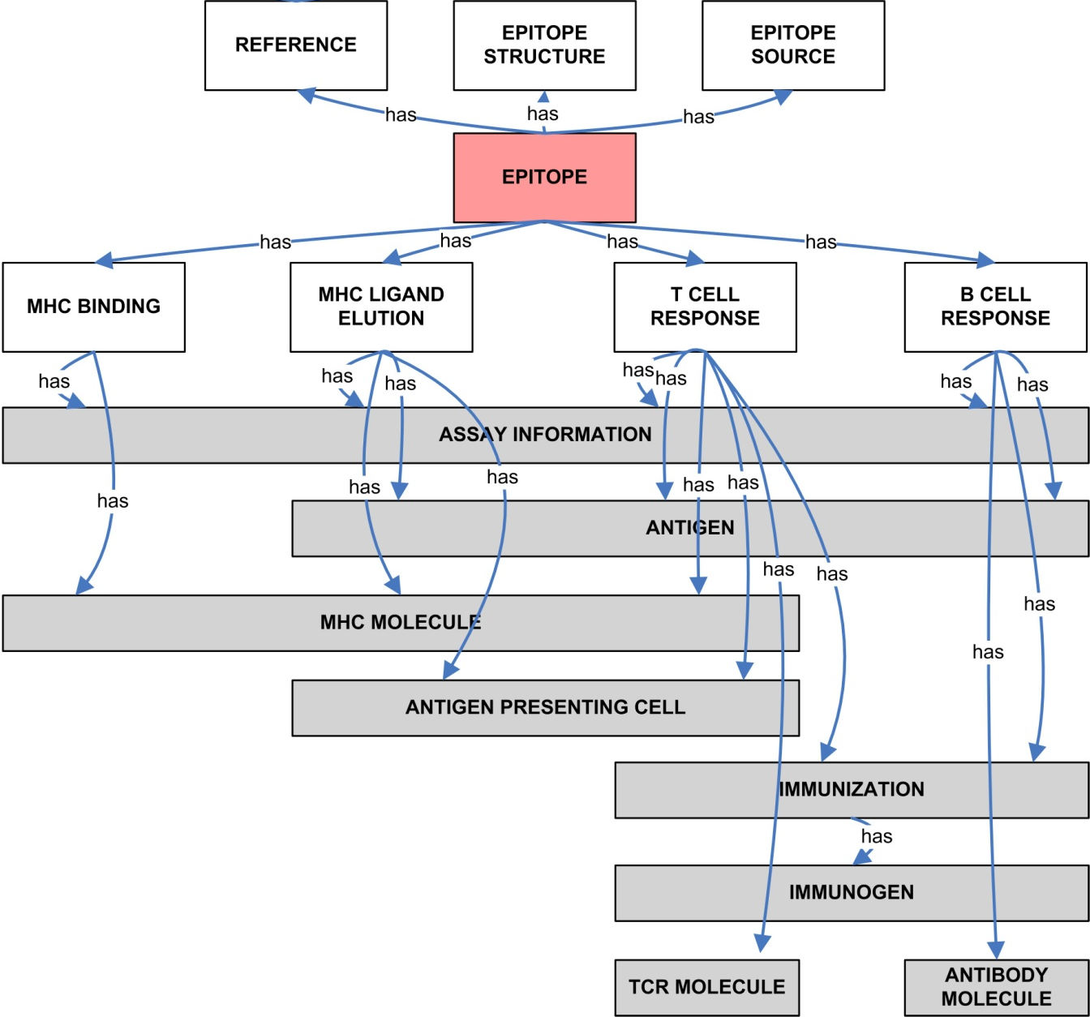
IEDB data structure
Sathiamurthy et al, Immunome Research, 2005

Slide 8
Goals of using OBI
Extendability of DB structure
Implementation of curation rules
Interoperability between different DBs
Enhanced queries

Slide 9
Implementation
Revised high level DB structure
Export of IEDB into OWL

Slide 10
Old IEDB data structure

Slide 11
OBI is missing immunology
OBI: Administration in vivo
IEDB:
    Immunization, Immunogen
    Host
    Adjuvant
OBI: ELISPOT = count protein secreting cells
IEDB:
    Antigen
    APC / Effector cells
    Immune Response
T
T
APC
T Cell Response
→IEDB needs an ONTology of Immune Epitopes (ONTIE)

Slide 12
Revised IEDB DB structure
Report
Process
is_a
is_a
T cell assay
MHC binding assay
B cell assay
Journal Article
Author submission
is_about
has participant
Conclusion:
Epitope role
Object
Borne by
Classes = Tables
Instances = Rows
→ DB is ‘naturally normalized’
Add new Object types in ONE place of the DB
is_a
molecule
cell
organism

Slide 13
Export of IEDB into owl
Create IEDB domain specific ‘view’ of OBI
Build ONTIE on top of ‘IEDB domain OBI’
(many things currently in ONTIE should move into OBI or elsewhere)
Export IEDB content as instances into OWL file

Slide 14
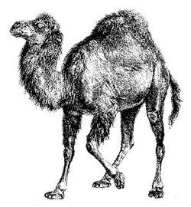






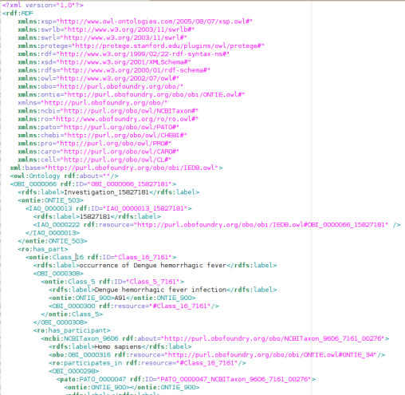
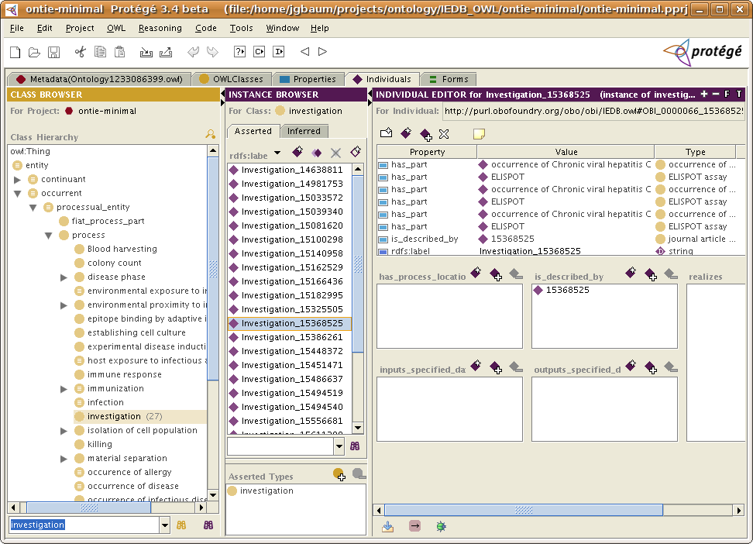

Notes:
Perl script queries IEDB
IEDB sends requested data to script
Perl script does some processing and sends the data through an OWL template
An OWL file is produced
The file is imported into Protege

Slide 15
Challenges
Maintaining consistent identifiers between exports
Not breaking Protégé/Pellet
  Protégé error messages are meaningful
  Pellet error messages are vague
Generalizable code
Many things still missing from OBI
Notes:
Generalizable code difficult because of the many conditionals.
e.g. differing relations between antigen and epitope, different object types, etc.

Slide 16
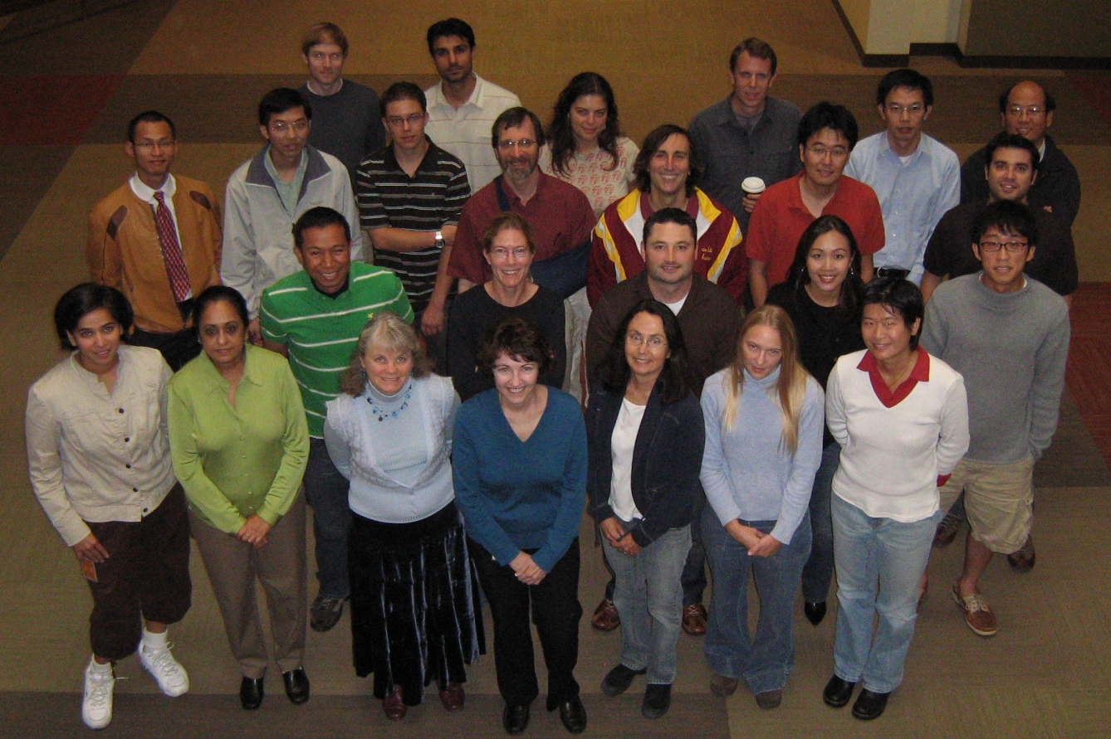
IEDB Team
La Jolla Institute for Allergy & Immunology
SAIC
Scott Stewart
Tom Carolan
Hussein Emami
San Diego Supercomputer Center
Phil Bourne
Julia Ponomarenko
Zhanyang Zhu
Technical University of Denmark
Ole Lund
Morten Nielsen
University of Copenhagen
Søren Buus
People I bothered at LIAI
Shane Crotty
Howard Grey
Alex Sette

